Slide 1
NSF supported Cybersecurity and
Computer Science Education Projects at UH Maui College
Debasis Bhattacharya, JD, DBA debasisb@hawaii.edu
http://maui.hawaii.edu/cybersecurity/ and http://maui.hawaii.edu/csp4hi
Supported by NSF Award # 1700562 & 1738824
August 30, 2022

Slide 2
Background
University of Hawaii Maui College
Serves Maui County - islands of Maui, Molokai and Lanai
165,000 or so resident population
2 Million or so tourists per year
Dropped 95% after March 2020!
Currently back to pre-Covid levels
2000+ full-time commuter students
20 or so Associate Degrees
2 Baccalaureate Degrees
60% or so women students
Median age of students ~26 years
Non-traditional students
Commuter island college

Slide 4
UHMC - Cybersecurity
CyberSecure: Extended Cybersecurity Education, Curriculum and Workforce Development (NSF ATE Award # 1700562, August 2017 to July 2021)
Cybersecurity Across the Disciplines - targeting students across various disciplines
Cyber Security Education, Curriculum, and Workforce Development (NSF ATE # 1204904, July 2012 to September 2015)
Core Cybersecurity Program Development - creating curriculum, certificates, pathways
Partners
Pacific Disaster Center, HDEP International and many small business on Maui County
Highlights - Details at project site: maui.hawaii.edu/cybersecurity
UHMC was designated a Center of Academic Excellence in Cybersecurity Education (4/19)
Most ABIT BAS graduates receive a Cybersecurity Certificate of Completion from NSA/DHS
UHMC created and has sustained a Certificate of Competence in Cybersecurity since 2015
More than a 100 high students from Maui County have taken cybersecurity courses at UHMC

Slide 6
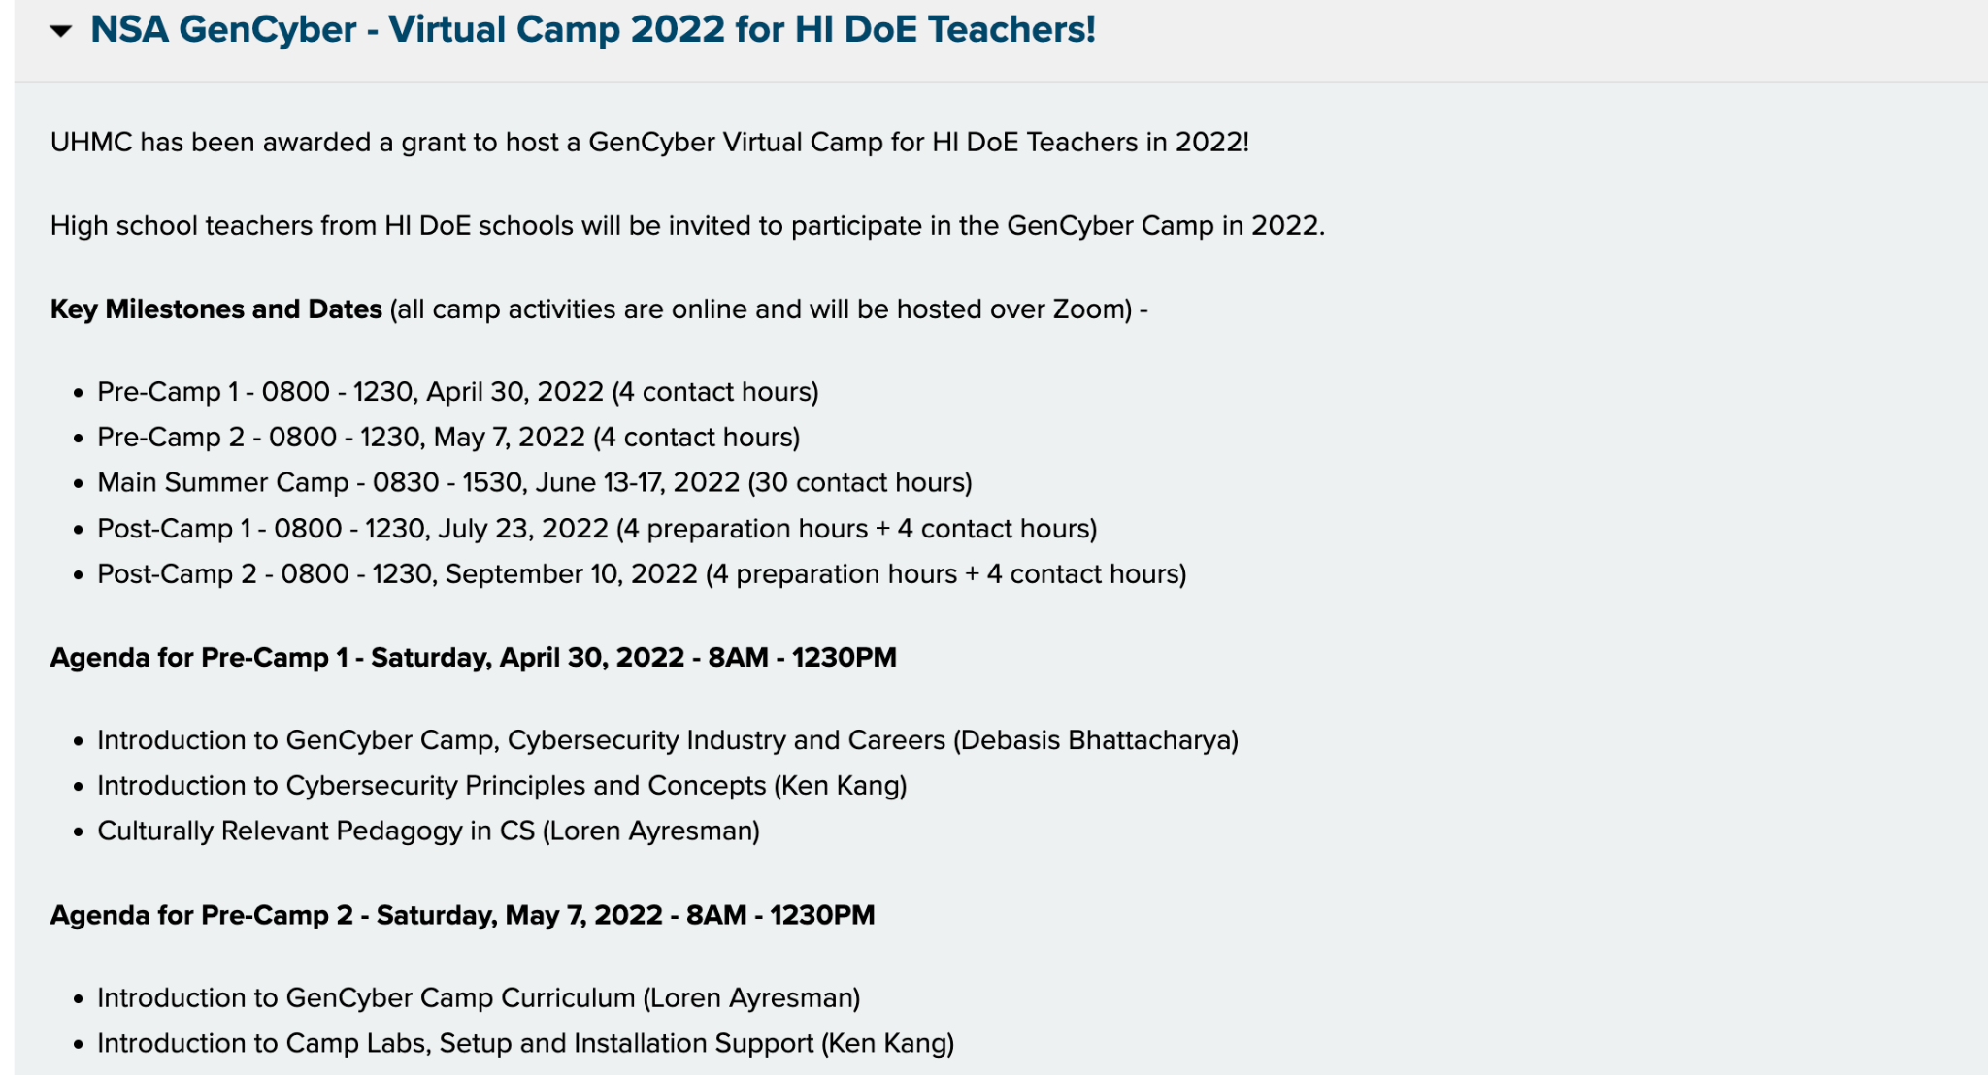

Slide 7
Introduction to Bitcoins, Blockchains, Ethereum, Smart Contracts
and NFTs
Debasis Bhattacharya (debasisb@hawaii.edu)
http://maui.hawaii.edu/cybersecurity/
Supported by National Convergence Tech Center
and NSF Award # 1700562
July 26, 2022

Slide 9
Source: https://maui.hawaii.edu/cybersecurity/

Slide 10
Source: https://maui.hawaii.edu/csp4hi/

Slide 11
UHMC - Computer Science Education
CSP4HI: Deployment of Computer Science Principles Courses within Secondary Schools in Hawaii (NSF STEM+C Award # 1738824, October 2017 to September 2021)
Training teachers across the public high schools in Hawaii to teach computer science
Research Practitioner Partnership project where teachers collaborate with researchers
Partners - Hawaii Department of Education
Highlights - Details at project site: maui.hawaii.edu/csp4hi
Cohort 1 - Trained 17 HI DoE teachers, impacted 11 HI DoE high schools
Cohort 2 - Trained 19 HI DoE teachers, impacted 14 HI DoE high schools
Cohort 3 - Trained 24 HI DoE teachers, impacted 16 HI DoE high schools
The CSP4HI project had a dramatic impact on the # of high schools which offered AP CSP between SY 2017 and SY 2021, and the number of female/underrepresented participants

Slide 12
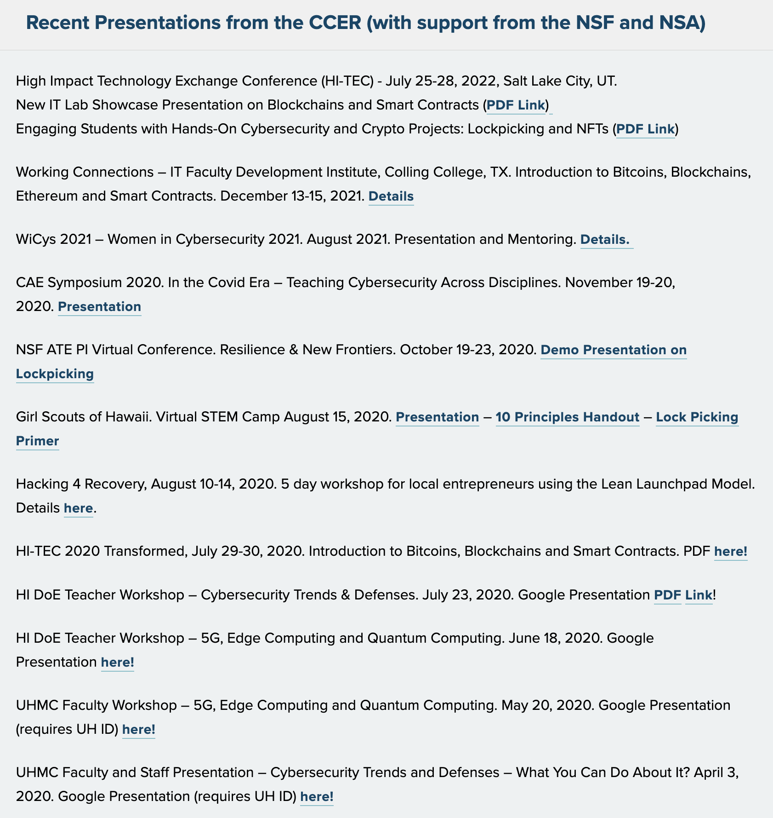

Slide 13
Submitted for SIGCSE 2019
Presented at HI-TEC 2018 Conference

Slide 14
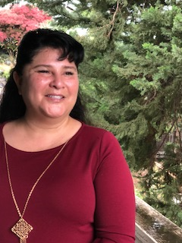
HI-TEC Conference 2018 Presentation - Case Study
Awareness of Malware in Small Medical Practices
Location of Study - Maui
Duration of Study - Spring 2018
Student Researcher - Lorraine Lopez-Osako
Student in the Applied Business and IT program
UH Maui College BAS graduate May 2018
Visited 15 small medical offices
Sent out survey to all doctors
Received 10 complete, valid responses
Created a CyberSecurity poster for doctor’s office

Slide 15
